Slide 1
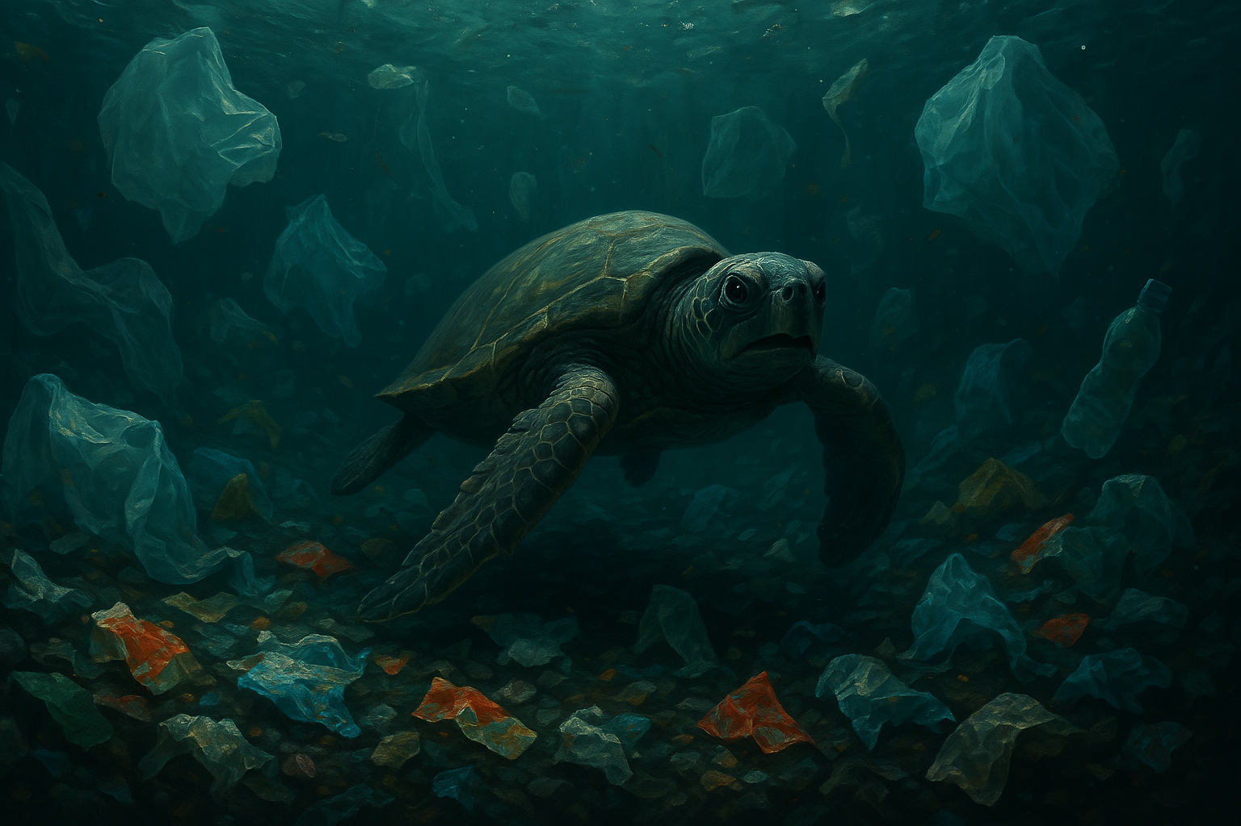
“Every year, about 8 to 10 million tons of plastics, including both macro plastics and microplastics, leak into the ocean ”
Sri Lanka throws away about 12 million plastic food wrappings and 4 million plastic bags each day

Slide 2


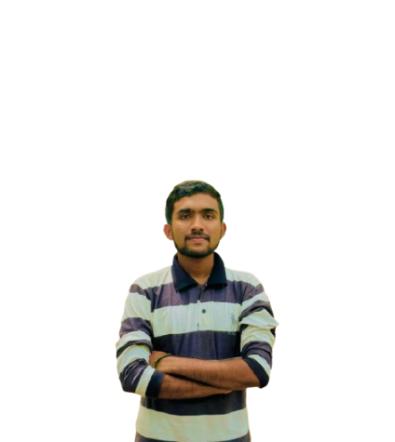
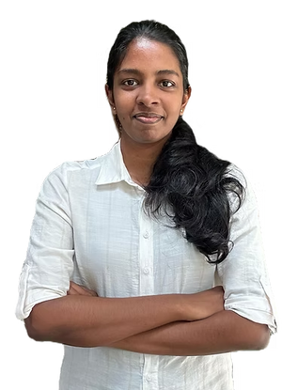
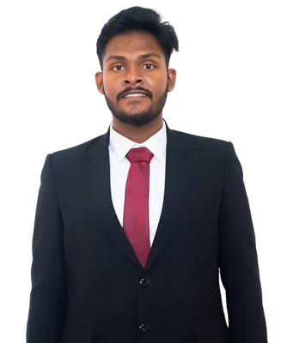
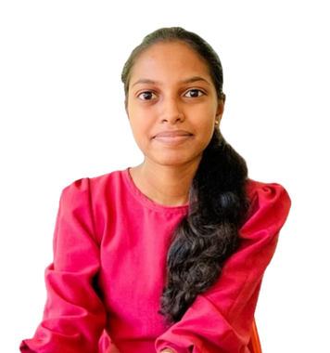
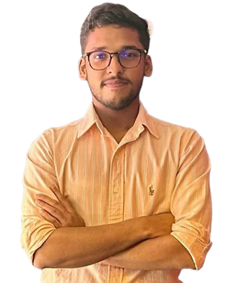

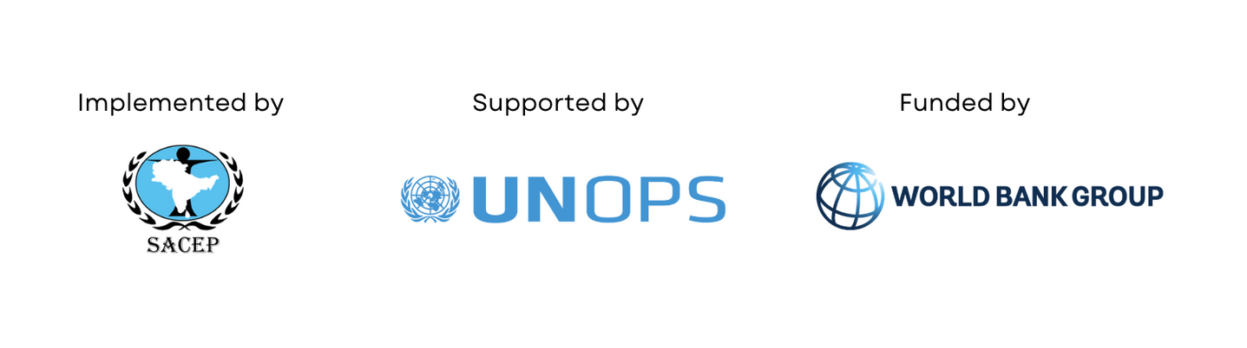
Bioplastic Revolution
Demitha Manawadu
Bsc U.G.
Electronics & Tel. Eng.
Benuri Edirisinghe
Bsc U.G.
Chemical & Process Eng.
Sahas Eashan
Bsc U.G.
Electronics & Tel. Eng.
Ridmini Hasari
Bsc U.G.
Chemical & Process Eng.
Banuka Liyanage
Bsc U.G.
BioMedical Eng.
Notes:
‹#›

Slide 3

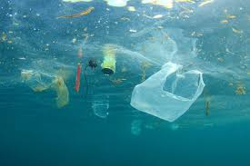
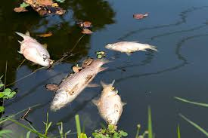
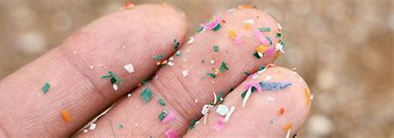
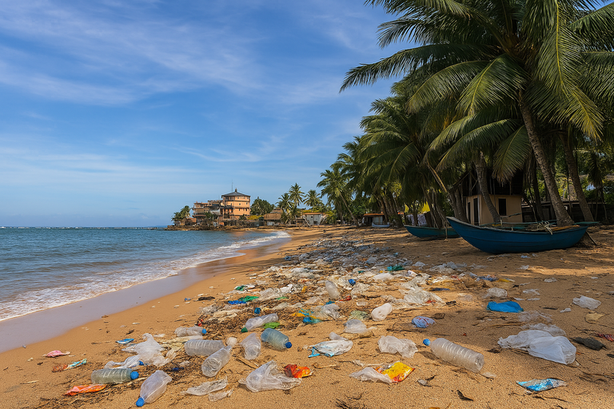
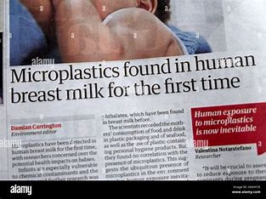
1. The Problem Statement and
Your Solution
The Problem
The growing accumulation of plastic waste in Sri Lanka's coastal areas is causing severe environmental pollution and health risks, threatening marine ecosystems, local communities, and public health.
River Pollution
Microplastics in breast Milk
Hikkaduwa Beach
Notes:
‹#›

Slide 4
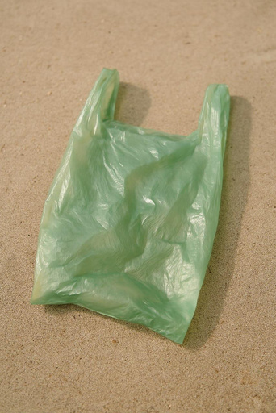

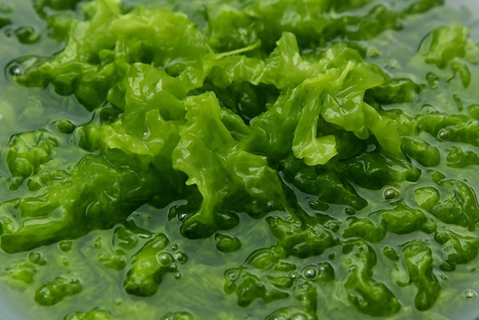
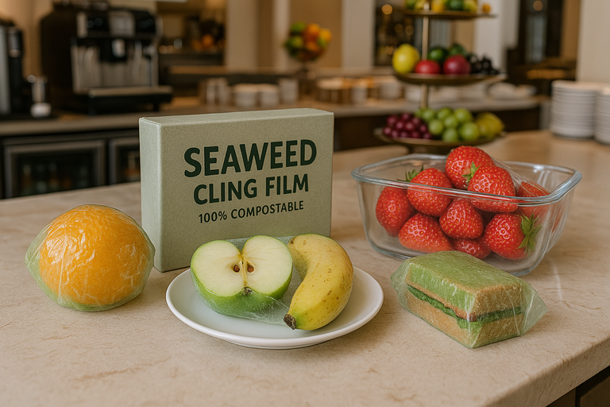
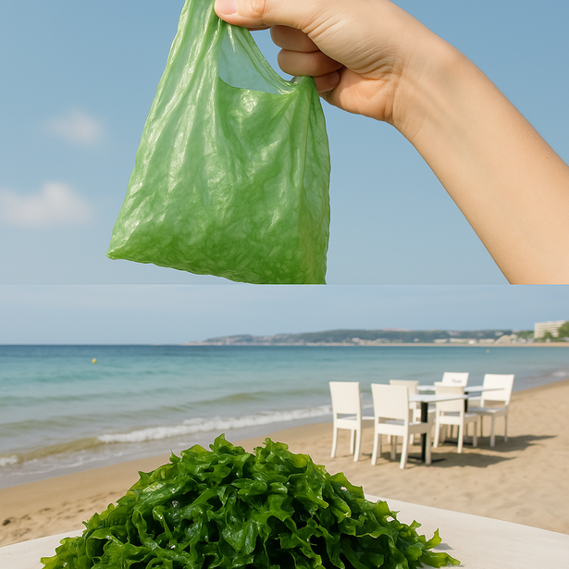
1. The Problem Statement and
Your Solution
Our Solution: BioPlastic Revolution
Seaweed-Based Bioplastic with a Sustainable Management System
Our Vision: To reduce ocean and river pollution by introducing seaweed-based bioplastics to seaside restaurants and hotels, driven by a Sustainable Management System for lasting impact.
Notes:
‹#›

Slide 5
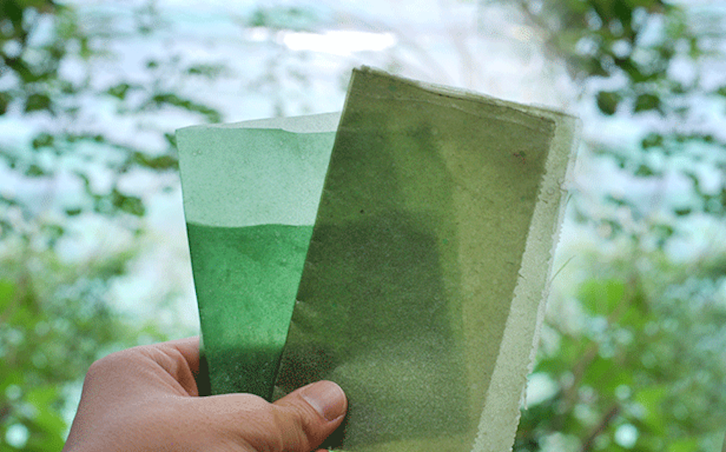

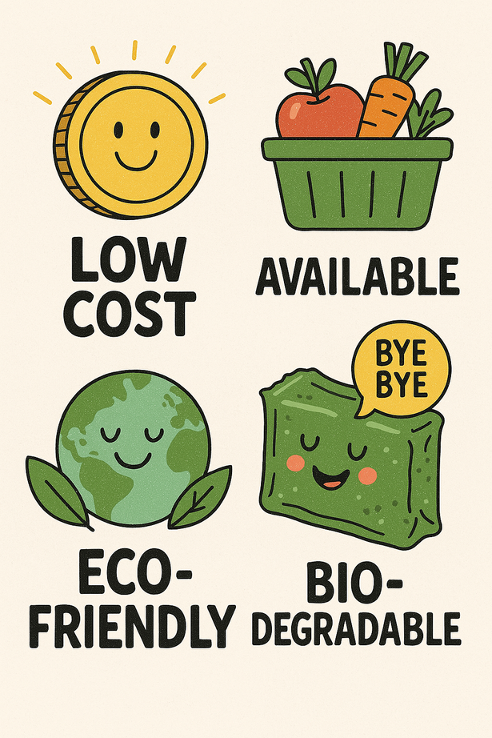
2. Proposed Solution
and Innovative Potential
Our Solution
To introduce a biodegradable, bioplastic-based
packaging made from seaweed to put a stop to
the growing plastic issue.
Low Cost
Available
Eco-friendly
Bio-degradable
Notes:
‹#›

Slide 6
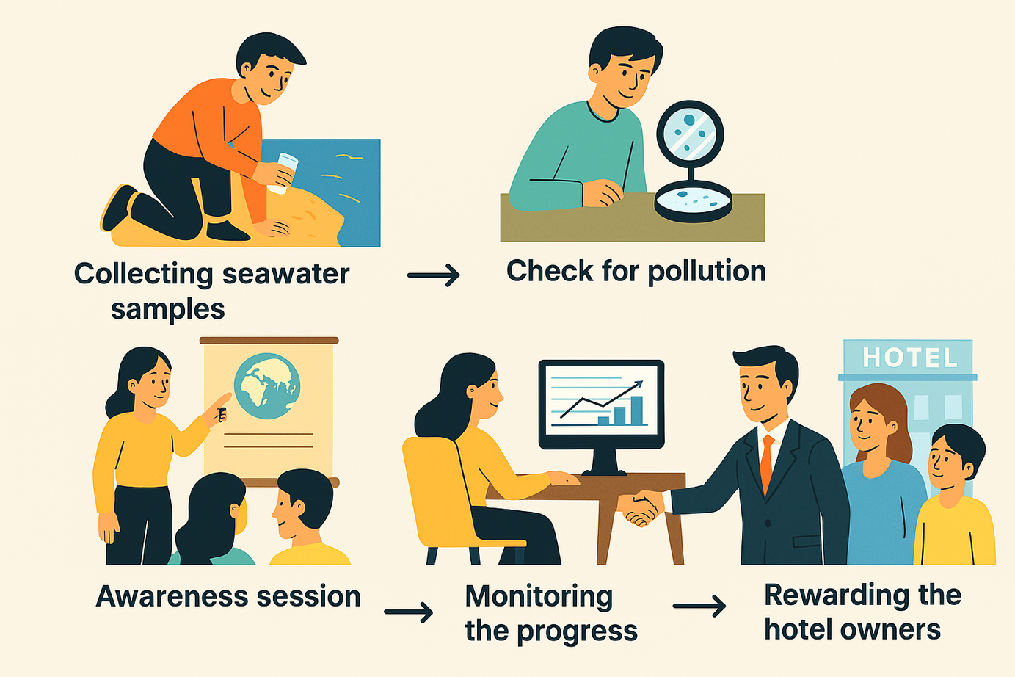
2. Proposed Solution
and Innovative Potential
OUR UNIQUE MANAGEMENT SYSTEM
Notes:
‹#›

Slide 7
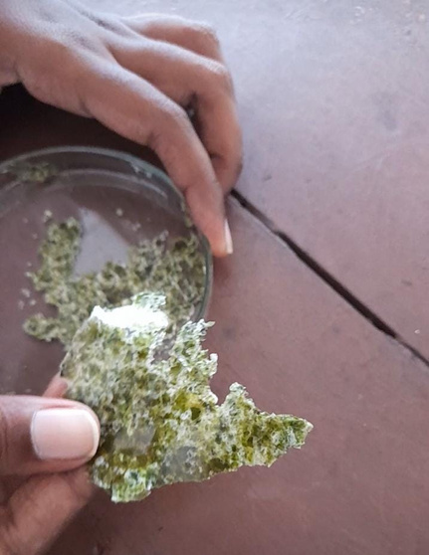
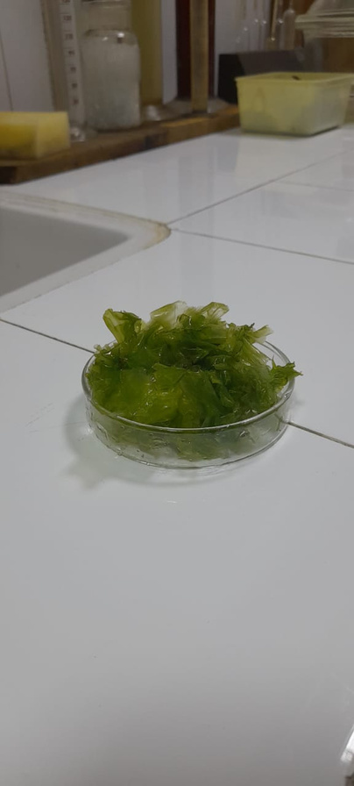
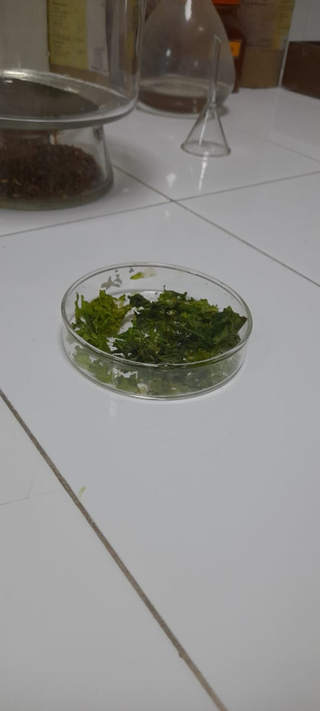
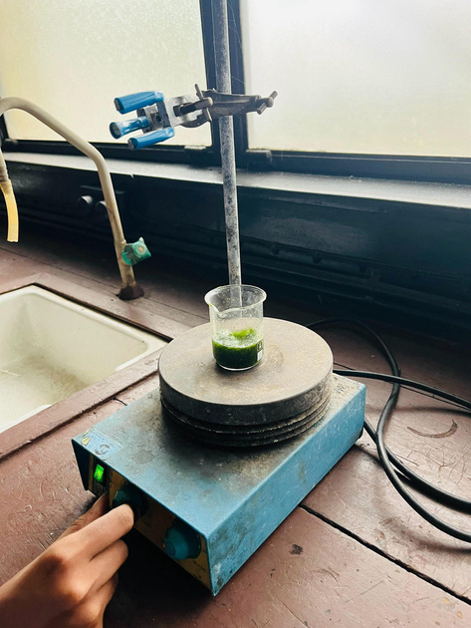
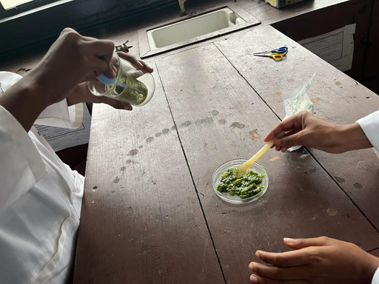

2. Proposed Solution
and Innovative Potential
Innovativeness
Straightforward method
Low energy requirement
Low cost
Technical Description
Notes:
‹#›

Slide 8

2. Proposed Solution
and Innovative Potential
Scalability
&
Feasability
Global Market
South Asian Region
Plants in
South Asian
Coastal Areas
Success!
Nationwide
Coastal Areas
Nationwide
demand due
to popularity
Southern Coastal Areas
Abundance
of seaweed
Abundance
of seaweed

Slide 9

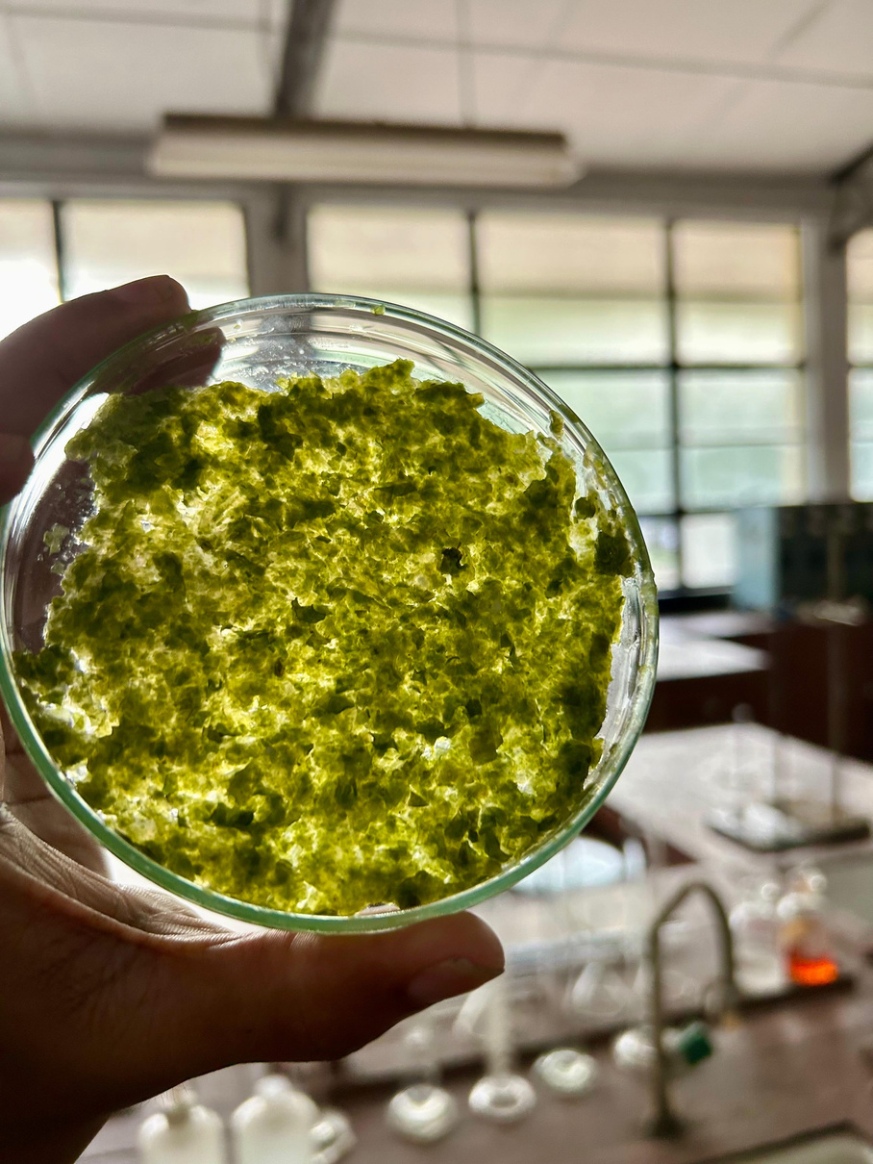
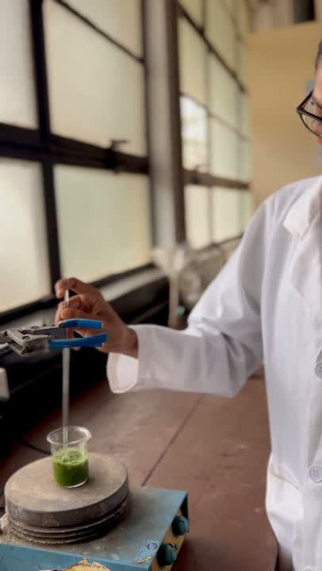

2. Proposed Solution
& Innovative Potential
Readiness
Notes:
‹#›

Slide 10
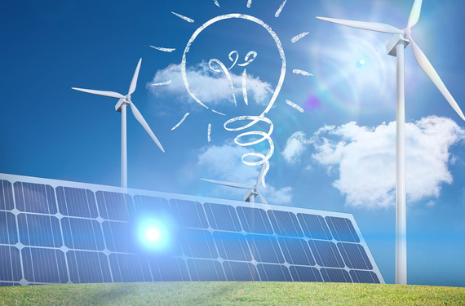
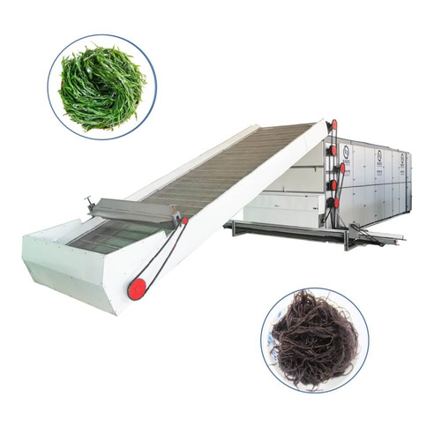
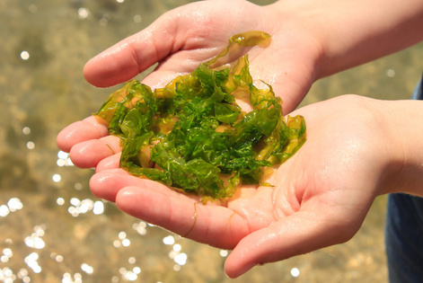
3. Work Plan,
Required Resources and Scalability
Work Plan and Timeline:
Resources Needed
Phase 01 | Research and Feasibility Study | March-May ( 3 months )
Phase 02 | Prototype Development | June-September ( 3 months)
Phase 03 | Pilot Plant Design | October - February 2026 ( 5 months )
Phase 04 | Scaling up and Commercialization | February 2027 ( 1 year )

Slide 11
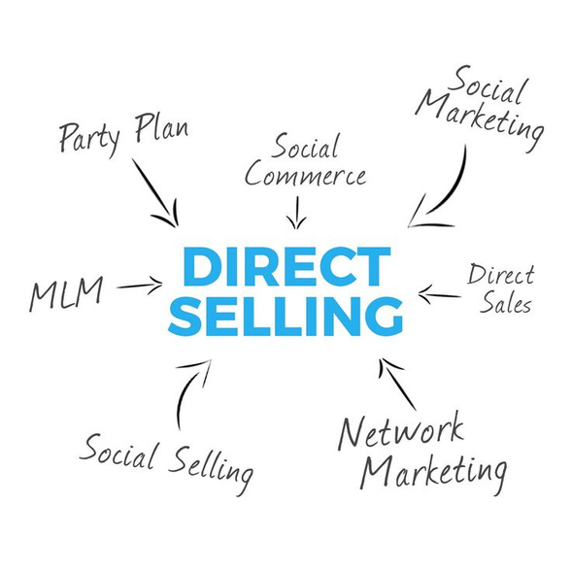
4. Financial Sustainability
& Scaling
Revenue & Sustainability Model:
Phased market entry starting with local restaurants
Generating revenue through direct sales consultation services.
Cost-effectiveness:
Low-cost abundant raw materials.
65% reduced energy consumption.
Creating a multiplier effect where each $1 invested generates $3.75 in economic benefits

Slide 12
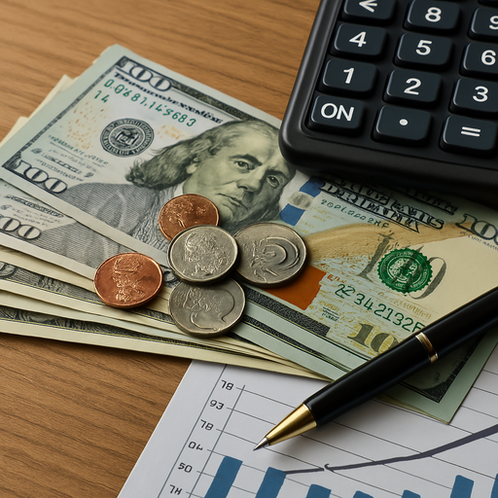
4. Financial Sustainability & Scaling
Replication & Scaling:
Addressing shared South Asian plastic pollution challenges through adaptable coastal corridor model.
Creating regional standards and advocacy network

Slide 13




5. Stakeholder Engagement
and Regional Collaboration
Key Stakeholders:
How will you engage them?
Key Beneficiaries and Outreach?
Regional Collaboration:
Seaweed Farmers
Hotels/Restaurants
Biotech Startups
Partner in awareness campaigns
Biodegrability
research
Eco-conscious Businesses
Local Economy
Government & Environmental Agencies
Easily adaptability
Environmental NGOs
Marine Conservation Groups

Slide 14
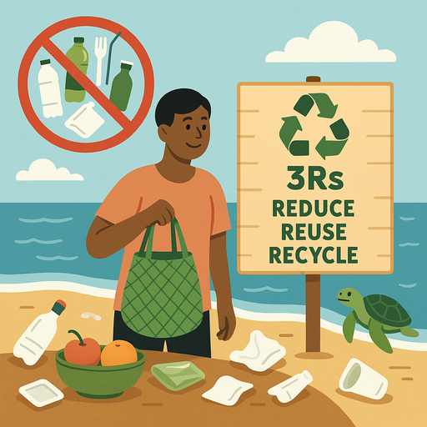
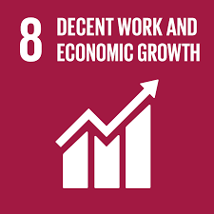
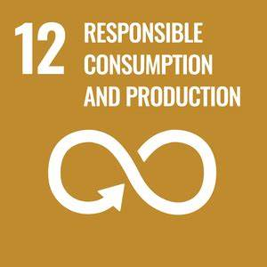
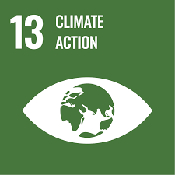
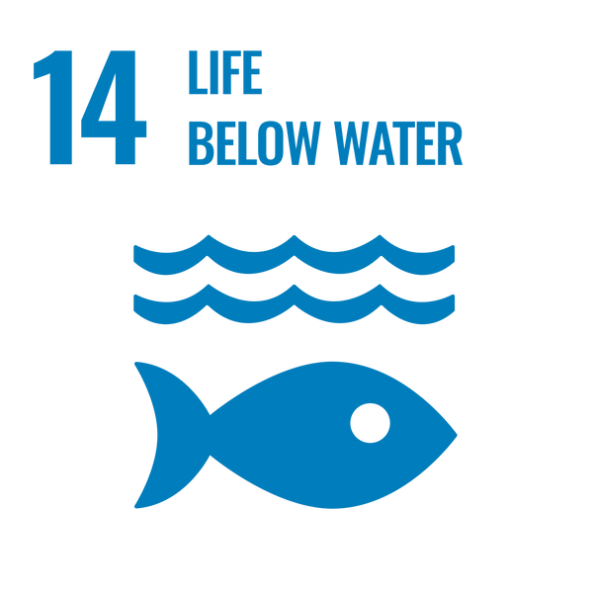
6. Policy Integration, Environmental
Sustainability & Social Inclusion
National & Sub-National Policies
1) Sri Lanka’s Ban on Single-Use Plastics (2021 & 2023)
2) National Policy on Waste Management (2019): Promotes the 3Rs
3) Marine Pollution Prevention Act (2008))
Global Policies & Agreements
1)UN Sustainable Development Goals (SDGs)
Contributes to SDG 8 , SDG 12, SDG 13 , and SDG 14.
2)Basel Convention on Plastic Waste (2019)
3)Paris Agreement (2015)
4)Global Plastics Treaty (Ongoing):

Slide 15
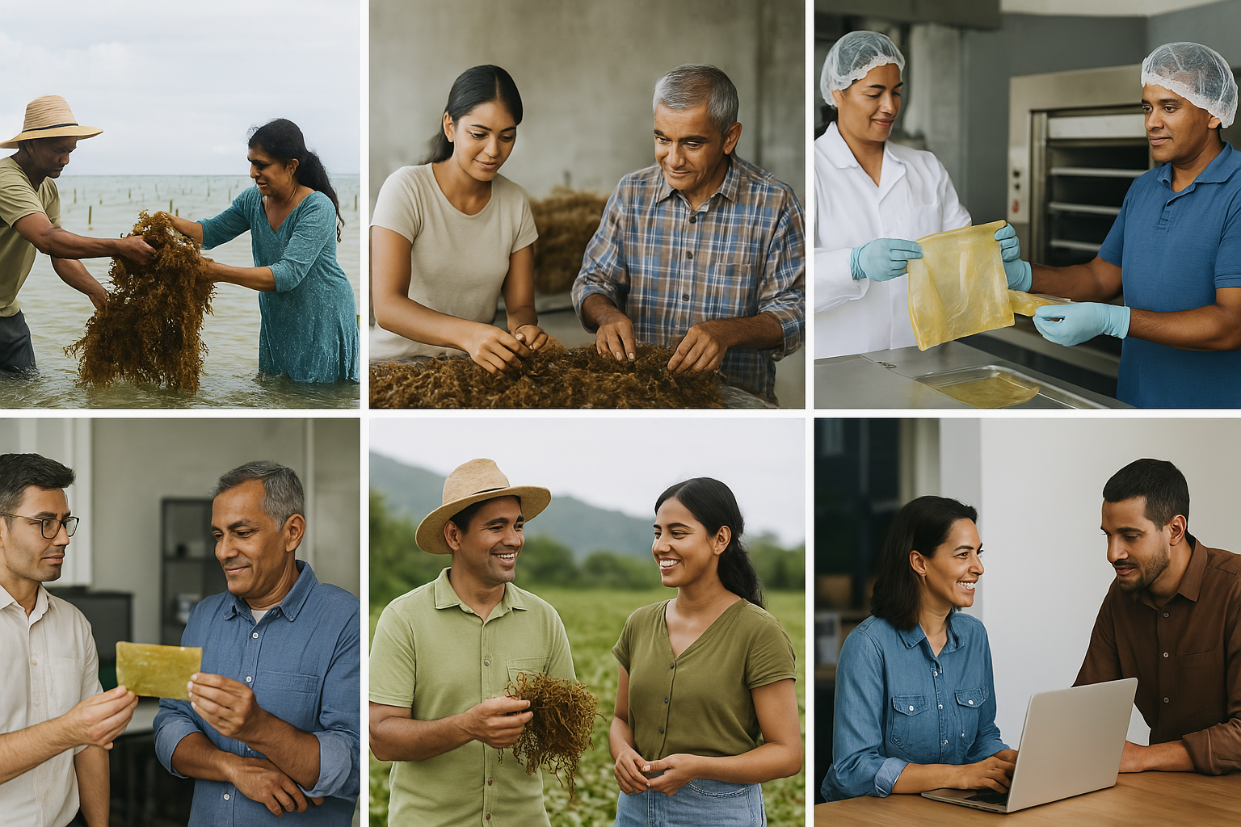

6. Policy Integration, Environmental
Sustainability & Social Inclusion
Social
Inclusion
Seaweed farmimg
Seaweed Processing
Bioplastic Manufacturing
Monitoring system-Through Website
Awareness sessions
Marketing

Slide 16
7. Conclusion
We will be able to reduce the plastic waste generation from 12 million to 8.4 million after two years!

Slide 17
Thank You

